Slide 1
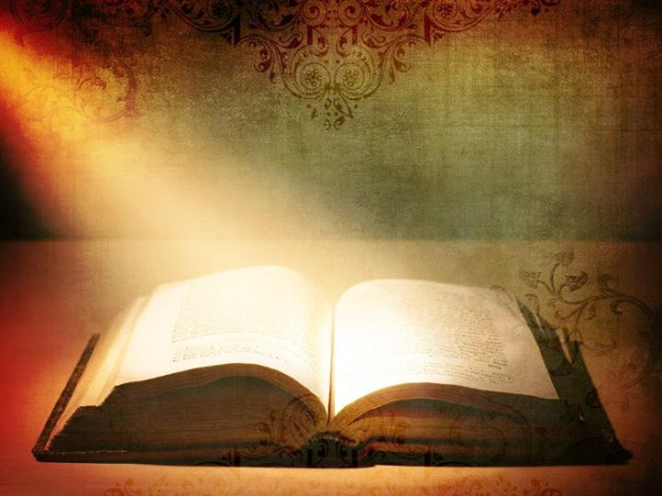
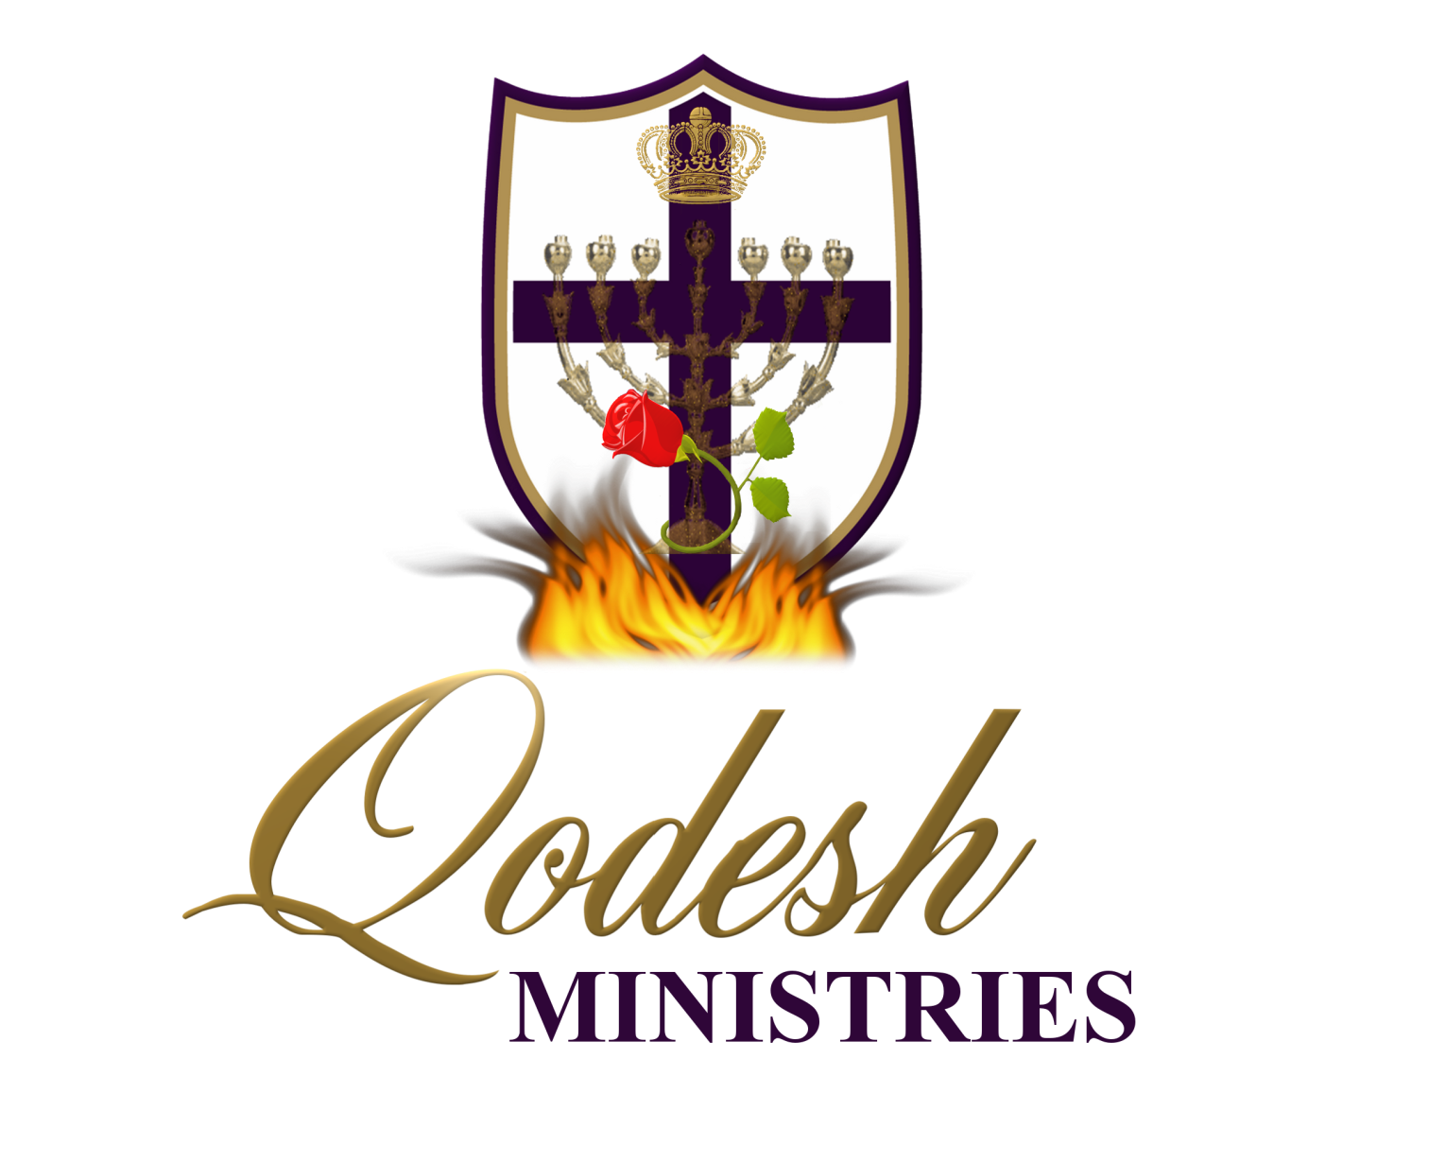

Slide 2
RECOGNITION
THE MESSIANIC PROPHECY BIBLE PROJECT
http://www.messianicbible.com
HEAR O ISRAEL
www.hearoisrael.org
SHEEPFOLD GLEANINGS WRITTEN BY JULIE PARKER
www.sheepfoldgleanings.com
MESSIANIC ISRAEL ALLIANCE
http://www.messianicisrael.com
AZAMRA TORAH FOR OUR TIME – RABBI AVRAHAM GREENBAUM
http://www.azamra.org

Slide 3
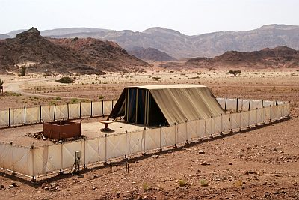
TERUMAH “Heave Offering”
TORAH: Exodus 25;1-27:19
HAFTARAH: 1 Kings 5:26-6-13
B’RIT CHADASHAH: Mark 10-11, 2 Corinthians 9:1–15
All references: The Scripture 1998+ unless otherwise noted

Slide 4
TABERNACLE AND יהושע
In the book of John, יהושע made this comment:
“For if you believed Mosheh, you would have believed Me, since he wrote about Me. (John 5:46)
If Moses wrote about יהושע, and so much of what Moses wrote about was about the tabernacle, then the tabernacle must be about יהושע, correct? In order to have the proper understanding of the tabernacle, it is crucial that we understand this very important concept: Messiah is not just a head. He has a body and WE ARE His BODY!
And you are a body of Messiah, and members individually. (1 Corinthians 12:27)
So then, if the tabernacle is about יהושע, then the tabernacle becomes a picture of us also since we are the body of Messiah. At this point in time the body is dispersed and not at all unified, so it would make sense that the completed tabernacle would be a picture of the Messiah (head) and the unified body of Messiah, this being a future event.

Slide 5
HEAVEN ON EARTH
יהוה wanted Moses to build the earthly tabernacle as an exact replica of the heavenly model:
“According to all that I show you – the pattern of the Dwelling Place and the pattern of all its furnishings – make it exactly so. (Exodus 25:9)
The structure that would be built according to this heavenly pattern would bring יהוה’s holy presence to the earth. It was a uniting of the spiritual with the earthly. When His people were obedient to every detail of the plan, it allowed the glory of יהוה to be in their midst! They became a testimony to the surrounding nations that their Elohim protected and dwelt with them. They were one with Him, and as long as they stuck with the plan, they were invincible.

Slide 6
THE PATTERN
After the first instructions before anything is actually built, we have the sin of the golden calf and how Moses will beg for the people’s lives and secure atonement for them through the mercy of יהוה. Then what follows is the actual making of the tabernacle and the priestly clothing. Exodus ends with the dedication of the tabernacle and the most exciting part:
And the cloud covered the Tent of Meeting, and the esteem of יהוה filled the Dwelling Place. (Exodus 40:34)
The reason for looking at this overview is to see a pattern that can be described as a “sandwich form”.
• Explanation of יהוה’s plan for the tabernacle
• Sin and יהוה’s plan for dealing with it
• Implementation of the tabernacle plan
In a nutshell, this is the pattern:
• יהוה has a plan
• Man sins and יהוה must deal with it
• יהוה’s plan prevails

Slide 7
THE PURPOSE
What was the main purpose of the building of the tabernacle?
“And they shall make Me a Set-apart Place, and I shall dwell in their midst. (Exodus 25:8)
The purpose of the tabernacle is for Him to dwell among us. How many times has this been His plan and something has interrupted that plan?
Dwelt with Adam and Eve in the Garden until sin
During the Exodus He dwelt with corporate Israel in the tabernacle. However, because of sin the Ark of the Covenant was taken and the glory departed
And she called the child Iḵaḇoḏ, saying, “The esteem has departed from Yisra’ĕl!” because the ark of Elohim was taken and because of her father-in-law and her husband. And she said, “The esteem has departed from Yisra’ĕl, for the ark of Elohim was taken.” (1 Samuel 4:21-22)

Slide 8
THE PURPOSE con’t
During the time of Solomon He dwelt with corporate Israel in a permanent dwelling in Jerusalem. But again because of sin and unfaithfulness the glory departed when the Northern Kingdom was exiled to Assyria and the Southern Kingdom was taken captive to Babylon.
And when Shelomoh had ended praying, fire came down from the heavens and consumed the burnt offering and the slaughterings. And the esteem of יהוה filled the House. (2 Chronicles 7:1)
יהושע came and dwelt with the people. יהוה will bring a solution to the sin problem, because in Him we become the righteousness of יהוה. This is what allows Him to dwell with us.
But Elohim proves His own love for us, in that while we were still sinners, Messiah died for us. (Romans 5:8, 6:6) and For He made Him who knew no sin to be sin for us, so that in Him we might become the righteousness of Elohim. (2 Corinthians 5:21)

Slide 9
TODAY
Because of our righteousness in Messiah, His glory can dwell within us as each of us become little individual tabernacles.
יהושע answered him, “If anyone loves Me, he shall guard My Word. And My Father shall love him, and We shall come to him and make Our stay with him. (John 14:23)
Do you not know that you are a Dwelling Place of Elohim and that the Spirit of Elohim dwells in you? (1 Corinthians 3:16)
Our future is that heavenly tabernacle that Moses saw the pattern for up on the mountain. This is the fulfilment of יהוה’s plan that we had interrupted by sinning:
And I heard a loud voice from the heaven saying, “See, the Booth of Elohim is with men, and He shall dwell with them, and they shall be His people, and Elohim Himself shall be with them and be their Elohim. (Revelation 21:3)

Slide 10
LEVELS OF HOLINESS
When a man and a woman come together, they become “one”…echad in Hebrew. The heavenly picture that Moses saw was the “oneness” of Messiah and His bride, yet within the pattern was also a picture of the entire plan of salvation that would deal with the sin that so often had separated Him from her. The Tabernacle and the mountain each had three levels of holiness. As the body of Messiah is portrayed in the Tabernacle, we can assume the same three levels of holiness there:
• Lower part of the mountain – those who had been redeemed from Egypt. Outer court – those who had dealt with their sin at the altar of sacrifice.
• Mountain slope - יהוה called Moses, Aaron, Nadab, Abihu, and 70 elders to experience His Presence and to have a fellowship meal with Him. Holy Place – those of the priesthood who tend to the showbread and the menorah.
• Mountain top - Moses (Torah) and Joshua (Yeshua) ascended the mountain for the giving of the Ten Words/Commandments (Exo 24:12-13). Holy of Holies – only the High Priest would enter here once a year.

Slide 11
HOLY OF HOLIES
So, brothers, having boldness to enter into the Set-apart Place by the blood of יהושע, by a new and living way which He instituted for us, through the veil, that is, His flesh, and having a High Priest over the House of Elohim, let us draw near with a true heart in completeness of belief, having our hearts sprinkled from a wicked conscience and our bodies washed with clean water. (Hebrews 10:19-22)
Hebrews 10:19 says that we (the body) may ENTER the Holy of Holies. But the bride actually LIVES there:
He who dwells in the secret place of the Most High, Who abides under the shadow of the Almighty, (Psalms 91:1)
Where is the shadow of the Almighty? It is under the wings of the cherubim that shadow the ark in the Holy of Holies:
“And the keruḇim shall be spreading out their wings above, covering the lid of atonement with their wings, with their faces toward each other, the faces of the keruḇim turned toward the lid of atonement. (Exodus 25:20) and Let me dwell in Your Tent forever, Let me take refuge in the shelter of Your wings.(Psalms 61:4)

Slide 12
While we are still scattered among the nations, we are still individual sanctuaries (tabernacles) of the living Elohim.
“Therefore say, ‘Thus said the Master יהוה, “Although I have sent them far off among the gentiles, and although I have scattered them among the lands, yet I was for them a set-apart place for a little while in the lands to which they came.” ’ ..I shall gather you from the peoples, and I shall assemble you from the lands where you have been scattered, and I shall give you the land of Yisra’ĕl.” ’ (Ezekiel 11:16-17)
The Holy of Holies will be the safe place for יהוה’s bride during the time of tribulation:
Go, my people, enter your rooms, and shut your doors behind you; hide yourself, as it were, for a little while, until the displeasure is past. (Isaiah 26:20) and For in the day of evil He hides me in His booth; In the covering of His Tent He hides me; On a rock He raises me up. And now my head is lifted up above my enemies all around me; And I offer in His Tent with shouts of joy; I sing, yea, I sing praises to יהוה. (Psalms 27:5-6)

Slide 13
SUKKAH
Psalm 27:5 and in other verses, יהוה refers to a the “secret place of His tabernacle”. This will “secretly” keep us safe, yet what is this place? It translates from the word “sukkah”, as the temporary dwellings we live in during Sukkot. During the tribulation we live in His very own “sukkah”.
How great is Your goodness, Which You have laid up for those fearing You, Which You have prepared for those taking refuge in You In the sight of the sons of men! In the secrecy of Your presence You shall hide them from the plots of man; You shelter them in a booth from the strife of tongues. (Psalms 31:19-20)
The above verse points to the “secret place” as being the place of “His Presence”. We already know the “secret place” is in the Tabernacle and we know “His Presence” is in the Holy of Holies. As the Almighty keeps His bride safe, others will learn of who He is and the demands of His holiness, the hard way.

Slide 14
SIGN AND A WONDER
Those who trust in יהוה and His Torah will be “for signs and wonders in Israel”:
“יהוה of hosts, Him you shall set apart. Let Him be your fear, and let Him be your dread. “And He shall be for a set-apart place, but a stone of stumbling and a rock that makes for falling to both the houses of Yisra’ĕl, as a trap and a snare to the inhabitants of Yerushalayim. “And many among them shall stumble and fall, and be broken and snared and taken.” Bind up the witness, seal the Torah among my taught ones. And I shall wait on יהוה, who hides His face from the house of Yaʽaqoḇ. And I shall look for Him. Look, I and the children whom יהוה has given me – for signs and wonders in Yisra’ĕl from יהוה of hosts, who dwells in Mount Tsiyon. (Isaiah 8:13-18)
Because of the sacrifice of Yeshua, we have been able to host the presence and the glory of the Almighty in our own individual sanctuaries.

Slide 15
WHY THE FOCUS?
Hidden within the symbolism of the tabernacle is the entire story of salvation – both of the individual and of the entire body of Messiah. Having accepted salvation is NOT the end of the story, nor should it be the ultimate goal of a believer. Far too often believers have only focused on eternal life in the coming world, but there is another type of salvation. יהושע speaks to this:
יהושע said to him, “I am the Way, and the Truth, and the Life. No one comes to the Father except through Me. (John 14:6)
He is the “way”, and we must follow Him in the same way the Israelites followed the cloud and the pillar of fire through the wilderness. He is the truth….His Word is truth. When we are obedient to the truth it enables us to dwell within His tabernacle during times of trouble. And of course He is the life….there is life and safety in the shadow of the Almighty. The New Jerusalem, the Holy of Holies in the tabernacle, the bridegroom with His bride….they’re all the same thing! This is the reason for the 50 chapters concerning the tabernacle!

Slide 16
CONTRIBUTION
And יהוה spoke to Mosheh, saying, “Speak to the children of Yisra’ĕl, that they take up a contribution for Me. From everyone whose heart moves him you shall take up My contribution. (Exodus 25:1-2)
The best translation of the Hebrew, because of verb usage, is “take up, for me, a terumah (contribution).” There are several Hebrew words that can be used for “offering” or “contribution”.
Why would יהוה choose “terumah” in these verses? The word “Terumah” (tav-reish-vav-mem-hey) is Strong‟s #8641 and means “offering” or “contribution” as in a “heave offering” because it’s from the root word “ruhm” which means “to elevate” or “raise up high”. The “terumah” is also the “offering” or the “portion of an offering” given to the priests from all the gifts of the Children of Yisra‟el that were given unto Yahweh, as in ‘And the right thigh you give to the priest as a contribution from your peace offerings. ‘He among the sons of Aharon, who brings the blood of the peace offering, and the fat, the right thigh is his for a portion.(Leviticus 7:32-33, 22:12) This is the portion that the priests were to eat.

Slide 17
TERUMAH
“Terumah” is spelled “tav-reish-vav-mem-hey”. If the mem stands alone (remember mem is water and its number is 40, which means “time of learning”); left are the letters in the word “Torah”. Torah is spelled “tav-vav-reish-hey”. So, if we look at this as two words, we have “learning” and “Torah”….. “learning Torah”.
And, this is word is “Terumah”; the portion of an offering that the priest eats. Last parsha we read ‘And now, if you diligently obey My voice, and shall guard My covenant, then you shall be My treasured possession above all the peoples – for all the earth is Mine – ‘and you shall be to Me a reign of priests and a set-apart nation.’ Those are the words which you are to speak to the children of Yisra’ĕl.” (Exodus 19:5-6) So, regarding the Torah, all of B‟nei Yisra‟el (including those who sojourn with) are to eat (partake) of this “Terumah”.

Slide 18
COHANIM
Simon Peter confirm this:
But you are a chosen race, a royal priesthood, a set-apart nation, a people for a possession, that you should proclaim the praises of Him who called you out of darkness into His marvellous light, (1 Peter 2:9)
And Apostle John confirm this:
Yoḥanan, to the seven assemblies that are in Asia: Favour to you and peace from Him who is and who was and who is coming, and from the seven Spirits that are before His throne, and from יהושע Messiah, the trustworthy witness, the first-born from the dead, and the ruler of the sovereigns of the earth. To Him who loved us and washed us from our sins in His own blood, and has made us sovereigns and priests to His Elohim and Father, to Him be esteem and rule forever and ever. Amĕn. (Revelation 1:4-6)

Slide 19
יהושע THE TERUMAH
So, if we are indeed priests, then this “Terumah” is ours to eat. And, what is it? “Torah”. And, this Torah is the “Living Water” and the “Bread of Life”. It’s the “manna” that comes down from heaven. In fact it’s literally been to us, Ephraim, the “hidden manna” that יהושע spoke about in: “He who has an ear, let him hear what the Spirit says to the assemblies. To him who overcomes I shall give some of the hidden manna to eat. And I shall give him a white stone, and on the stone a renewed Name written which no one knows except him who receives it.” ’ (Revelation 2:17)
יהושע is the word made flesh according to John 1:1 and And the Word became flesh and pitched His tent among us.. (John 1:14) If יהושע is the word made flesh and the Word is our “Terumah” and the one that was lifted up for us the following makes sense: “I am the bread of life. “Your fathers ate the manna in the wilderness and they died. “This is the bread which comes down out of the heaven, so that anyone might eat of it, and not die. “I am the living bread which came down out of the heaven. If anyone eats of this bread, he shall live forever. .. “For My flesh is truly food, and My blood is truly drink. (John 6:48-55)

Slide 20
CONTRIBUTION
.. take up a contribution for Me. From everyone whose heart moves him you shall take up My contribution. (Exodus 25:1-2)
This “contribution” was to be “from anyone who wholeheartedly wants to give”. Only those stirred in their hearts with a desire to participate in this holy work are to donate their material goods. No one is to give grudgingly or out of a sense of duty but out of love and gratitude towards God.
As a bride: He wants all of us. However, He wants us to want to give all to Him. He’ll take only what we offer, as we are moved to surrender. Now, that’s a loving Husband.
“For Elohim so loved the world that He gave ..(John 3:16)
No one can out give יהוה. Generosity is one of His core attributes and He is gives generously. When He gave us יהושע He gave us His very best and most beloved of all. Moreover, everything we have also comes from the hand of יהוה. We should also, therefore, be willing to give back to His work cheerfully and willingly.

Slide 21
NEW COVENANT
In the New Testament portion of this week’s Parsha, the Word tells us that each of us should give as we have purposed in our heart, .. not of grief or of necessity, for Elohim loves a joyous giver. (2 Corinthians 9:7)
With this in mind, we also need to understand the spiritual law of sowing and reaping: .. He who sows sparingly shall also reap sparingly, ... (2 Corinthians 9:6) This principle doesn’t just apply to our financial giving, but is a spiritual law that applies to every area of our life. Whatever we are generous in dishing out, we are going to receive back in equal measure – whether that is anger, bitterness, judgment, criticism, and condemnation – or grace, mercy, kindness, encouragement and love. “For with what judgment you judge, you shall be judged. And with the same measure you use, it shall be measured to you. (Matthew 7:2) So let’s make sure that we are giving generous praise, encouragement, love, help, blessings, and all the good things that we would want to receive generously in return, including our material offerings. The generous being is enriched, And he who waters is also watered himself. (Proverbs 11:25)

Slide 22
FIFTEEN ITEMS
“And this is the contribution which you take up from them: gold(1), and silver(2), and bronze(3), and blue(4) and purple(5) and scarlet(6) material, and fine linen(7), and goats’ hair(8), and rams’ skins(9) dyed red, and fine leather(10), and acacia wood(11), oil for the light(12), spices (13) for the anointing oil and for the sweet incense, shoham stones(14), and stones to be set in the shoulder garment and in the breastplate(15). (Exodus 25:3-7)
15 is the numeric value of “Yud-Hey” or “Yah”. Also, in Genesis 7:20, when the flood covered the earth, the water was 15 cubits above the mountain tops. The door and gate curtains or “hangings”, as Scripture describes them in Exodus 27 and 38, for the Tabernacle were all 15 cubits high. And, the prophet paid 15 shekels as the “bride price” for the whore he married in Hoshea 3:1-2. Fifteen is also the numeric value of the letters in Yah‟s attribute of “Hod” (Chet-vav-dalet), meaning “glory”, “splendor” and “majesty”.

Slide 23
ITEM 1 - GOLD
The Hebrew word here is “zahab” (zayin-hey-bet), Strong‟s #2091. In addition to being a precious metal, it is a metaphor in Scripture for the splendor and brilliance of the heavens. Its root “zahah” means “to be fair” or “to shine”. Revelation 21:18 states that the New Jerusalem is clean gold like clear glass.
The first letter Zayin means crown, hey means revelation and bet is House. Here the gold would be “our crown of revelation inיהוה House”. The rabbis teach that gold represents the Love Elohim has for His people, Yisra’el. The numeric value of the letters in “zahab” equals 14; which equals “gift”, “beloved” or “David” and “dai (enough)”. While there are metals and minerals more costly, it is still the most sought after of the precious metals. By using “gold” in and on the set-apart objects throughout the Kodesh and Kodeshim ofיהוה 's Dwelling Place, His love for us is demonstrated. It’s not about gold in the sense of riches or wealth. These are all His anyway.

Slide 24
ITEM 2 - SILVER
The Hebrew word here is “keseph” (kuf-samech-fey), Strong‟s #3701. In addition to being a precious metal, silver (according to the rabbis) equates to “man”, much like gold does to Elohim. Silver throughout Scripture is money, the medium of exchange and purchase. That‟s why it is used as the “the ransom of the first-born”, the “bride price” and “יהושע betrayal price”.
Silver was used to purchase land, as in Abraham’s purchase of the Field and the Cave at Makpelah in Hebron and Jerimiah’s purchase of Anathoth. Now, Zechariah 13:9 refers to the refining of those who escape Israel in the day of Ya’aqob’s trouble; “And I shall bring the third into fire, and refine them as silver is refined, and try them as gold is tried. They shall call on My Name, and I shall answer them. I shall say, ‘This is My people,’ while they say, ‘יהוה is my Elohim.’ also, “And who is able to bear the day of His coming, and who is able to stand when He appears? For He is like the fire of a refiner, and like the soap of a launderer. “And He shall sit as a refiner and a cleanser of silver. And He shall cleanse the sons of Lĕwi, and refine them as gold and silver, and they shall belong to יהוה, bringing near an offering in righteousness. (Malachi 3:2-3)

Slide 25
ITEM 2 – SILVER con’t
The numeric value of “keseph” equals 160; which equals “Cain”, “El Rescues” and “innocent”. Kuf means “strength”, samech means “support” and fey means “here, now”. The “silver” shows that “our strength and support is here, now”. By using silver for the sockets, rings and hooks in the assembling of the Tabernacle, יהוה shows how our love for Him is central to the structure of His Dwelling Place.
יהושע describes us this way in Revelation 3:12:
“He who overcomes, I shall make him a supporting post in the Dwelling Place of My Elohim, and he shall by no means go out. And I shall write on him the Name of My Elohim and the name of the city of My Elohim, the renewed Yerushalayim, which comes down out of the heaven from My Elohim, and My renewed Name.

Slide 26
ITEM 3 – BRONZE
The Hebrew word is “nekhoshet” and is translated by Jewish sources as “copper”. It is spelled “nun-chet-shin-tav” and is Strong‟s #5178. In addition to the metal “copper”, it means “hardened” (probably why it is translated as brass or bronze, hard alloys that contain copper).
It also means fetter, harlotry and lust. Interesting that the laver, the altar and its utensils were all made of this metal, since they involve cleansing, purification and atonement from sin and uncleanness. The numeric value of “nekhoshet” is 758; which equals “a fifth part” or “1/5”, which is very noteworthy in that 1/5 was to be added to an offering or a re-payment to redeem your house or your tithe, to purify and cleanse it. ‘And if he who sets it apart does redeem his house, then he shall add one-fifth of the silver of your evaluation to it, and it shall be his. (Leviticus 27:15) and And all the tithe of the land – of the seed of the land or of the fruit of the tree – belongs to יהוה. It is set-apart to יהוה. ‘If a man indeed redeems any of his tithes, he adds one-fifth to it. (Leviticus 27:30-31)
Nun means kingdom, chet means fear, shin means El Shaddai and tav means mark or sign. “In the kingdom, the fear of El Shaddai is our sign”.

Slide 27
ITEM 4 - BLUE MATERIAL
The Hebrew here says “tekeleth” which is Strong‟s #8504 and spelled “tav-kaf-lamed-tav”. Its name comes from a species of squid where this colour originated. In the processing it turns a cerulean blue. By tradition it is used as the thread of blue in the tzit-tzit as it represents the floor under the throne of יהוה (the “brick” we examined last week), which is the colour of the clear sky.
The tav means inscribed as a mark, kaf means palm of the hand, lamed means to teach and tav means mark. יהוה says of Yisra’el, according to “See, I have inscribed you on the palms of My hands; your walls are always before Me. (Isaiah 49:16) By this, He teaches us and will mark us as His own. The numeric value of “tekeleth” is 850 which equals “sh‟mat‟im” or “those who are in obedience”. It is by obedience that we can enter into the service of יהוה 's Dwelling Place.

Slide 28
ITEM 5 – PURPLE MATERIAL
The Hebrew word is “argaman” (aleph-reish-gimmel-mem-nun) and is Strong‟s #0713. This too is a dye colour that comes from the water; specifically a shell fish. This shellfish was once very rare; but, now has made a comeback.
Aleph means Master or teaching, reish is beginning, gimmel is the bridge, mem means water and nun means kingdom. So, in Argaman is our “Master‟s teaching that is the beginning of the bridge through the Living Water to the Kingdom”. Yes, bridge through the Living Water; just as our forefathers crossed through the Reed Sea on a land bridge that יהוה provided to take them through to deliverance.יהוה 's Dwelling Place (whether the Tabernacle or the One in our heart) is the bridge between heaven and earth.
The numeric value of argaman is 294 which equals Melech Tzedek, the King of Righteousness.
No wonder purple is a royal colour.

Slide 29
ITEM 6 – SCARLET MATERIAL
The Hebrew word for this scarlet material is “shaniy” (shin-nun-yud) and is Strong’s word #8144 and is the colour derived from a specific worm which produces a deep scarlet dye, the colour of blood.
Now shin represents El Shaddai which is El is Sufficient, nun means kingdom and yud means hand. “Through El Shaddai, the Kingdom is at hand”.
The numeric value of “shaniy” is 360, which equals “my wife”. It is by His blood that we can come back to our Husband and can be His bride again.

Slide 30
ITEM 7 – FINE LINEN OR LINEN
The word for “linen” is “shesh” which is “shin-shin”. However in the Hebrew Torah there’s an added conjunction “and” with the word here. Shown as “v’shesh”, spelled “vav-shin-shin” and is Strong‟s #8336 and means “something bleached” or “made white”, like “white linen”.
In Scripture linen is used to symbolize purity and absence of sin. Vav means pillar and shin is El Shaddai, which is emphasized by the double shin. Here, we have a dual meaning also. First, that “יהוה is our Pillar”, as in And יהוה went before them by day in a column of cloud to lead the way, and by night in a column of fire to give them light, so as to go by day and night. The column of cloud did not cease by day, nor the column of fire by night, before the people. (Exodus 13:21-22) and second, “we are pillars in His Set-apart Sanctuary” “He who overcomes, I shall make him a supporting post in the Dwelling Place of My Elohim, and he shall by no means go out. And I shall write on him the Name of My Elohim and the name of the city of My Elohim, the renewed Yerushalayim, ..(Revelation 3:12) It is through a heart that has been made sinless we are made pillars in יהוה's Dwelling Place.

Slide 31
ITEM 7 – FINE LINEN OR LINEN
When the stock of the flax plant is ripe, it goes through a refining process. By soaking, drying and beating it we get long fibres that are woven and made into cloth called linen. Nevertheless, the linen curtain was of a very fine quality, and very white, even bright. The curtains denoted the righteousness of Messiah יהושע, the eternal Son Incarnate, which, by His holy life and His unfaltering obedience during His ministry on earth, He wrought for us. It points to the coming day when the Bride of Messiah will stand before יהושע and be arrayed in a brilliant white wedding dress, "...for the fine linen is the righteousness of the saints" (Rev. 19:8).
Linen also represents the righteous acts of the saints who have chosen to mirror their walk after יהושע and His ways. All three plants produce oils that provide healing and health benefits.

Slide 32
ITEM 8 – GOATS HAIR
How does goat’s hair tie-in? In Hebrew, goat‟s hair here also has the vav to denote “and”. So it is spelled vav-ayin-tzadee-yud and is pronounced “v’eitzy”. It is Strong‟s #5795 and is a “long-haired female goat”. “Eitzy” is from the root word azaz, meaning “to be strong” or “prevail”.
As vav means “pillar”, ayin is eye, tzadee means righteous and yud means hand. “Our Strong Tower, or Pillar (יהושע) is our Righteousness and the Mighty Right Hand”.
Goats’ hair is very strong stuff. It has been used throughout history, including today, for tents. In the sun, its weave relaxes to let even the smallest breezes through for cooling. In the rain, it swells to close-off the weave to keep moisture out.
Note: It is used for the curtains to cover יהוה‘‟s Dwelling Place and that it is a goat that is the sin offering.
The numeric value of eitzy is 176, which equals “v‟ een‟im” or “He made them wander” and “v‟atz alem”, “He delivered them”.

Slide 33
ITEM 9 – RAMS SKIN DYED RED
These rams’ skins were to be used as a covering over the goats hair curtains.
The word for “ram” in the Hebrew is “ahyil” and also means “doorpost” and “mighty, upright tree”, here, these are dyed red.
The Hebrew word for “red” used here is “adam”; which, in addition to “man”, means to be “red” or “ruddy”. The ground or soil is called “adamah”.
The numeric value of “ram” or “ahyil” (aleph-yud-lamed) is 41, which equals “tent”. The value of “adam” (aleph-dalet-mem) is 44, which equals “b‟ohel aw” or “in his tent” and “dam” or “blood”.
What we get with the “goat hair”, we see that it‟s the sin offering that allows “adam”, or man, to enter into the Dwelling Place of Elohim.

Slide 34
ITEM 10 – FINE LEATHER
Depending on the translation, or version, we read, we’ll see different words here. The ISR Scriptures simply says “fine leather”. The Hebrew word here is “tachash” and always appears with “owr” which is “hide” or “skin”. Now the origin of the word “tachash” is rather obscure, but apparently Egyptian.
Some Scripture versions translate it as “badger”. Gesenius‟ Hebrew-Chaldee Lexicon, Brown – Driver – Briggs and Talmudic references, all point to “dolphin” or “seal” skin. These were both common at that time in Egypt and they were used in the making of shoes; especially fine women’s shoes. Since these animals inhabit the water, their hides are “water proof” and would make an excellent outer layer of protection from the weather.
“tachash” is spelled tav-chet-shin. Tav is sign, chet means fear and shin is El Shaddai. So this outer covering for the Tabernacle is a “sign of those who fear El Shaddai”.
The numeric value of “tachash” is 708, which equals “toshav” or “sojourner” and “teshuvah” or “repent and return” and “tesh‟avoo”, “you shall abide”.

Slide 35
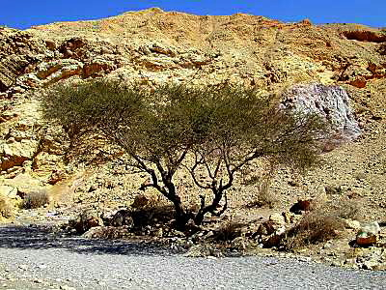
11 ITEM – SHITTIM WOOD
Some translations use “acacia wood” here. Now, acacia is another word for “mimosa tree”, which is a more common term. They are quite large and the wood from them would make some fairly substantial boards. But, the Middle Eastern variety, called shitta or shittim (plural) is quite different. It is small, gnarly and all twisted looking. In order to make boards from these for the Tabernacle, the ark, table, etc., these “sticks” would have to be “joined” or “fitted together Sha‟ul (Paul) said it best in Ephesians 2:19-22:
So then you are no longer strangers and foreigners, but fellow citizens with the set-apart ones and members of the household of Elohim, having been built upon the foundation of the emissaries and prophets, יהושע Messiah Himself being chief corner-stone, in whom all the building, being joined together, grows into a set-apart Dwelling Place in יהוה, in whom you also are being built together into a dwelling of Elohim in the Spirit.

Slide 36
11 ITEM – SHITTIM WOOD con’t
This is indeed the perfect picture of יהוה‘s Dwelling Place; whether a Tent made from boards and fabric or the Dwelling Place in heaven. Our mortal bodies are like the “Tent” (temporary). As Peter admonished the brethren in 2 Peter 1:12-14, he wrote; And so I intend to remind you of these matters again and again, though you know them and have been established in the present truth. But I think it is right, as long as I am in this tent, to stir you up by a reminder, knowing that the putting off of my tent is soon, even as our Master יהושע Messiah made clear to me. And, our “changed” heavenly bodies (bodies of light) are like the “Dwelling Place in Heaven” (representing the eternal).
We are all like “Shittim”. Yehezqel‟s two sticks are “little sticks”. We’re not much good for anything by ourselves. We have to learn to be community…. to fit together, to live as one people. Living in community with Judah, our brother. That’s the “restoration”.

Slide 37
11 ITEM – SHITTIM WOOD con’t
The word “unity” is a term people use, who generally want others to conform or compromise to their understanding of things. “unity” is not “community”. The “comm” is common belief, common halacha and common practice. We’re not going to agree on everything; but, we can restore and build a relationship on the things we have in common. We can love יהוה our Elohim; and in turn, love each other, as we love ourselves.
It’s great to visit, go to conferences, even celebrate (as in Sukkot) with other believers that share some things in common with us. That’s practicing unity and it’‟s good. But, community is where you live. And, a community has rules, as in Torah. Those in community look after and protect each other; and, in community, relationships grow and people draw closer. This is the pattern for the restoration of the Kingdom. Acts 5:32 refers to much more than just possessions when it says; And the group of those who believed were of one heart and one being. And no one claimed that any of his possessions was his own, but they had all in common.

Slide 38
11 ITEM – SHITTIM WOOD con’t
We see the beginnings of this in Acts 15, when the Council of Jerusalem met and set guidelines for those returning to Elohim from the nations to follow, in order to have fellowship with יהושע in verses 19-21; “Therefore I judge that we should not trouble those from among the gentiles who are turning to Elohim, but that we write to them to abstain from the defilements of idols, and from whoring, and from what is strangled, and from blood.. “For from ancient generations Mosheh has, in every city, those proclaiming him – being read in the congregations every Sabbath.” This was the foundation on which began the community of יהושע.
“Shitta” here is spelled “shin-tet-hey” and is singular in these verses. “Shin” is El Shaddai, “tet” means inclination and hey means revelation. When we incline ourselves toward יהוה , El Shaddai, His inclination will be our revelation. He will reveal Himself to us.
An alternate meaning for “shitta” is “scourge”; as the shitta tree has large thorns which were used in scourging. The numeric value of “shitta” is 414 which equals “thistle” or “thorn” as well as “to sanctify”, “set apart” or make “kadosh”.

Slide 39
12 ITEM – “OIL” FOR LIGHT
This oil, in Hebrew “shemen” (shin-mem-nun) is Strong‟s #8081, meaning “olive oil”. Note: they were in the wilderness of Sinai and there weren‟t likely any olive orchards around. This oil would have come from Mitzrayim with them.
Shin refers to “El Shaddai”, and, while mem is “water”, it also means “womb” and nun is the “kingdom”. So, “from El Shaddai‟s womb, He brought forth the kingdom”. Oil also represents the “anointing of Ruach HaKodesh”. It is indeed through this “oil”, this “anointing”, that we are to bring His Light to the world.
The numeric value of shemen is 390, which equals “sh‟mayim” or “heaven”. It is truly the “dew of Heaven” spoken of in the Scriptures. Just as Moshe blessed Yisra’el just before his death, he said in “O Yeshurun, there is no one like Ěl, riding the heavens to help you, and on the clouds, in His excellency. “The Elohim of old is a refuge, and beneath are everlasting arms. ..“Blessed are you, O Yisra’ĕl! Who is like you, a people saved by יהוה, the shield of your help, and He who is the sword of your excellency! ..(Deuteronomy 33:26-29) This anointing is the fuel for our menorah…. our light made in a press.

Slide 40
ITEM 13 - SPICES
The Hebrew is “besem”, Strong‟s #1314 (bet-shin-mem), which means “sweet spices” or “perfume”. The rabbis teach that these spices are our praises and our prayers. They are indeed the “korban‟ot” or “offerings” of the “bulls of our lips” as Peter put it. People will tell you, and at times you may even feel that you can’t be part of Israel, make a note of this, In Isaiah 56:6-8 “Also the sons of the foreigner who join themselves to יהוה, to serve Him, and to love the Name of יהוה, to be His servants, all who guard the Sabbath, and not profane it, and hold fast to My covenant – them I shall bring to My set-apart mountain, and let them rejoice in My house of prayer. Their burnt offerings and their slaughterings are accepted on My altar, for My house is called a house of prayer for all the peoples.” The Master יהוה, who gathers the outcasts of Yisra’ĕl, declares, “I gather still others to him besides those who are gathered to him.”
“Besem” (bet-shin-mem); bet being “house”, shin represents “El Shaddai” and mem is “water”. We see that “the House of El Shaddai is a fountain of Living Water”. The numeric value of the letters in Besem is 342, equals “by My Name” and also “to be in the midst”.

Slide 41
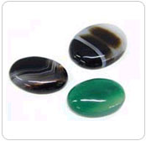
ITEM 14 – SHOHAM STONES
“Shoham” is the Hebrew word for “onyx”, spelled “shin-hey-mem” and is Strong‟s #7718. It is produced under much heat and pressure and a by-product of volcanic eruption. Its most common colour is black; but, it can be one of several colours. These are the stones chosen by Yahweh for the shoulders of the High Priest's ephod (garment) while in the Dwelling Place. They were set in gold (יהוה’s love) and engraved on each were the names of six of the tribes of Yisra’el. So the Kohen HaGadol would bear the twelve tribes upon his shoulders during his service in the Dwelling Place of Yahweh.
“Shin-hey-mem” means that El Shaddai‟s revelation is in His Word. What is His revelation? Shimon Kepha said it best in in order that the proving of your belief – much more precious than gold that perishes, and proven by fire – might be found to result in praise and respect and esteem at the revelation of יהושע Messiah, whom having not seen, you love; in whom you exult with unspeakable and esteemed joy, yet not seeing, but believing, obtaining the goal of your belief: a deliverance of lives. (1 Peter 1:7-9). “Shin-hey-mem” equals 345, which equals “Moshe” (delivered through water).

Slide 42
15 ITEM - STONES
“stones” for the shoulder garment and the breastplate of the High Priest. These were precious stones representing the twelve tribes of Yisra‟el, who are very precious to יהוה. These were always over the heart of the Kohen HaGadol when he was before יהוה. They are always on the heart of our High Priest, even today, as He sits at יהוה‘s right hand. In fact, as we look at this later, we’ll see how these stones (these tribes) were arranged around יהוה‘s Dwelling Place and what significance there is to this. Stones represent you and me as we are all to be “living stones” in the Dwelling Place of our Elohim.
The Hebrew word for stone is “eben” (aleph-bet-nun) which declares that the strength of the House is the Heir to the Kingdom. Eben is made up of two other words; aleph-bet (Ab) which means Father and “bet-nun” (ben) which means Son. As true living stones we indeed contain “Father/Son attributes” dwelling in within us.

Slide 43
MAKE ME A SANCTUARY
“And they shall make Me a Set-apart Place, and I shall dwell in their midst. “According to all that I show you – the pattern of the Dwelling Place and the pattern of all its furnishings – make it exactly so. (Exodus 25:8-9)
יהוה instructed Moses to make an exact replica of this tabernacle so the earthly one would be a perfect “shadow” of the heavenly one that is already prepared for His bride. יהוה revealed the heavenly pattern ahead of time so that it would not be foreign to His Bride when she arrived and that she would feel comfortable living in the tabernacle pattern before the actual wedding event took place. The "house" יהוה made for His Bride is His Kingdom, that is the heavenly tabernacle. It is a dwelling place. The functions of service in His Kingdom are called the realms of the Kingdom. The realms of the Kingdom are all the words recorded in their marriage covenant/ketubah at Mount Sinai that the bride vowed to keep, the ketubah that is written and sealed in blood before יהוה h. Moses represents the shadow of יהושע, who has gone for a time to prepare a place for His bride to tabernacle with (Exodus 24:18; Hebrews 8:1-2, 5).

Slide 44
BLUEPRINT
Wikipedia: A blueprint is a type of paper-based reproduction usually of a technical drawing, documenting an architecture or an engineering design. Referring to any detailed plan.
The preparation is a step-by-step process. Our pathway to growth in experiential holiness and increasing intimacy with יהושע is also a step by step process: For it is: command upon command, command upon command, line upon line, line upon line, here a little, there a little. (Isaiah 28:10). The beatific vision [to see Elohim] is for those only whose spiritual eyesight has been prepared [step by step] for its reception. We cannot come to the throne of God, save through the outer court and through the sanctuary--[the steps are]:
Sacrifice and redemption [Brazen Altar; Salvation by faith].
Cleansing [Basin; Holiness/Evangelical].
Illumination [Lampstand, Pentacost/Azusa].
Communion/fellowship [Table and Bread; Abba's Love]
Intimacy and vision [Altar of Incense; Prophetic Intercession / Third Day Vision (Hosea 6:1-2).

